Slide 1
PROCESS MODEL

Slide 2
LINEAR MODEL
REQUIREMENT ANALYSIS
DESIGN
IMPLEMENTATION
TESTING
MAINTENANCE

Slide 3


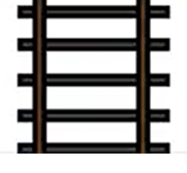

Slide 4
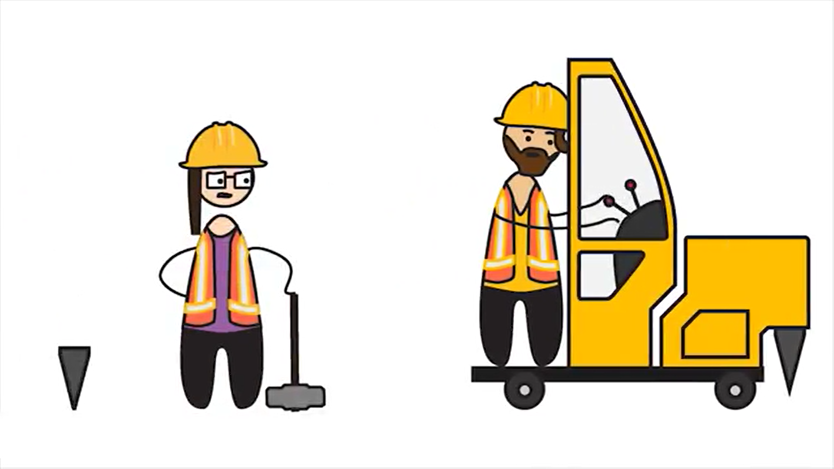

Slide 5


Slide 6
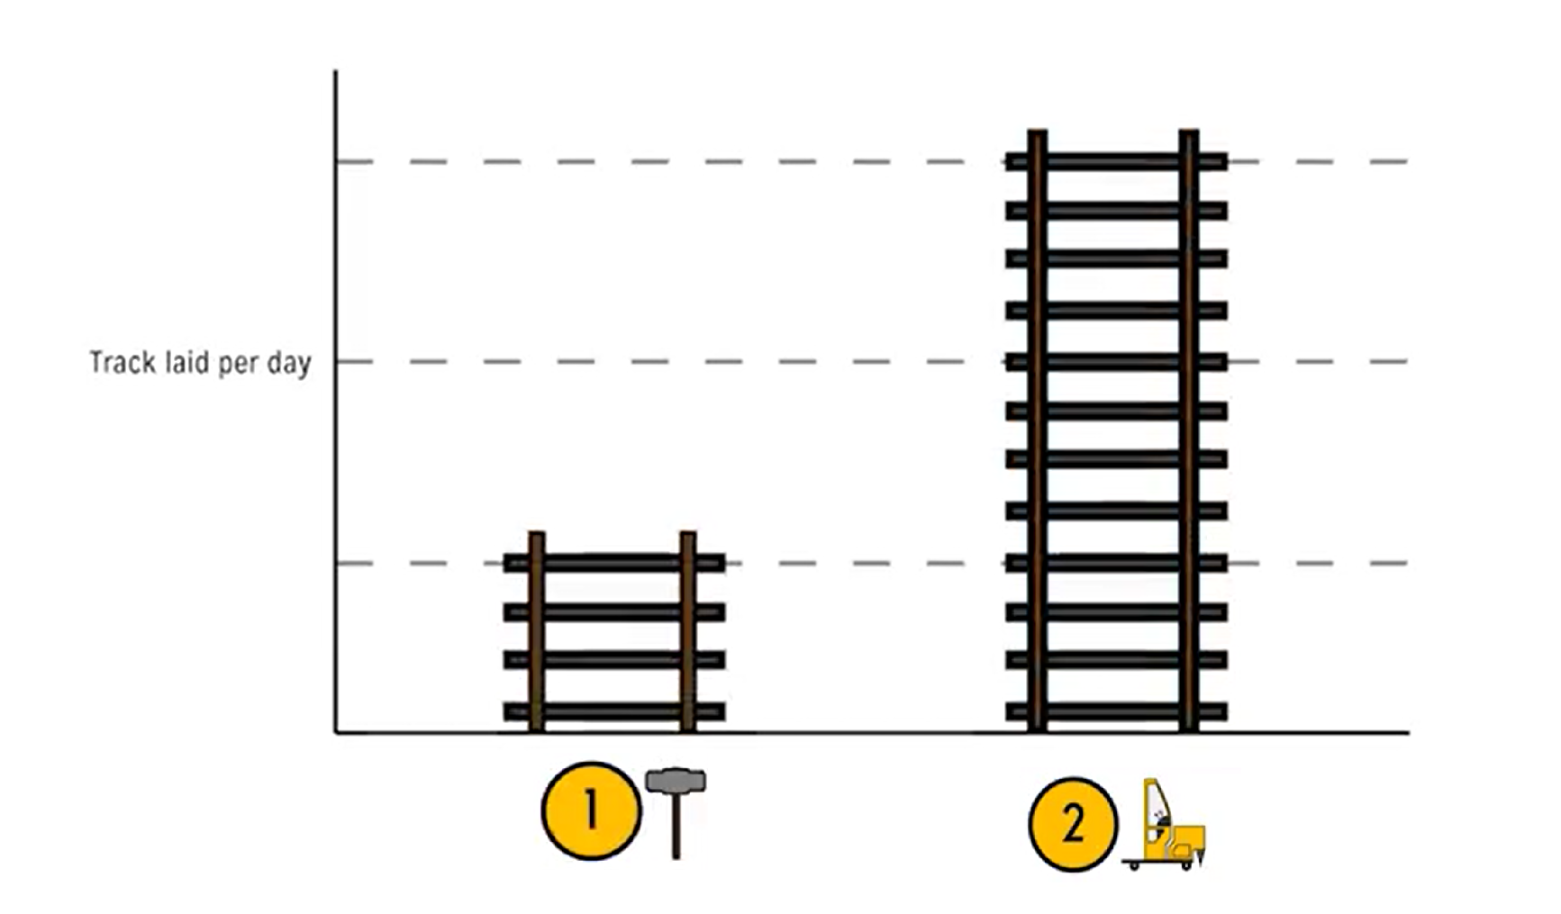

Slide 7
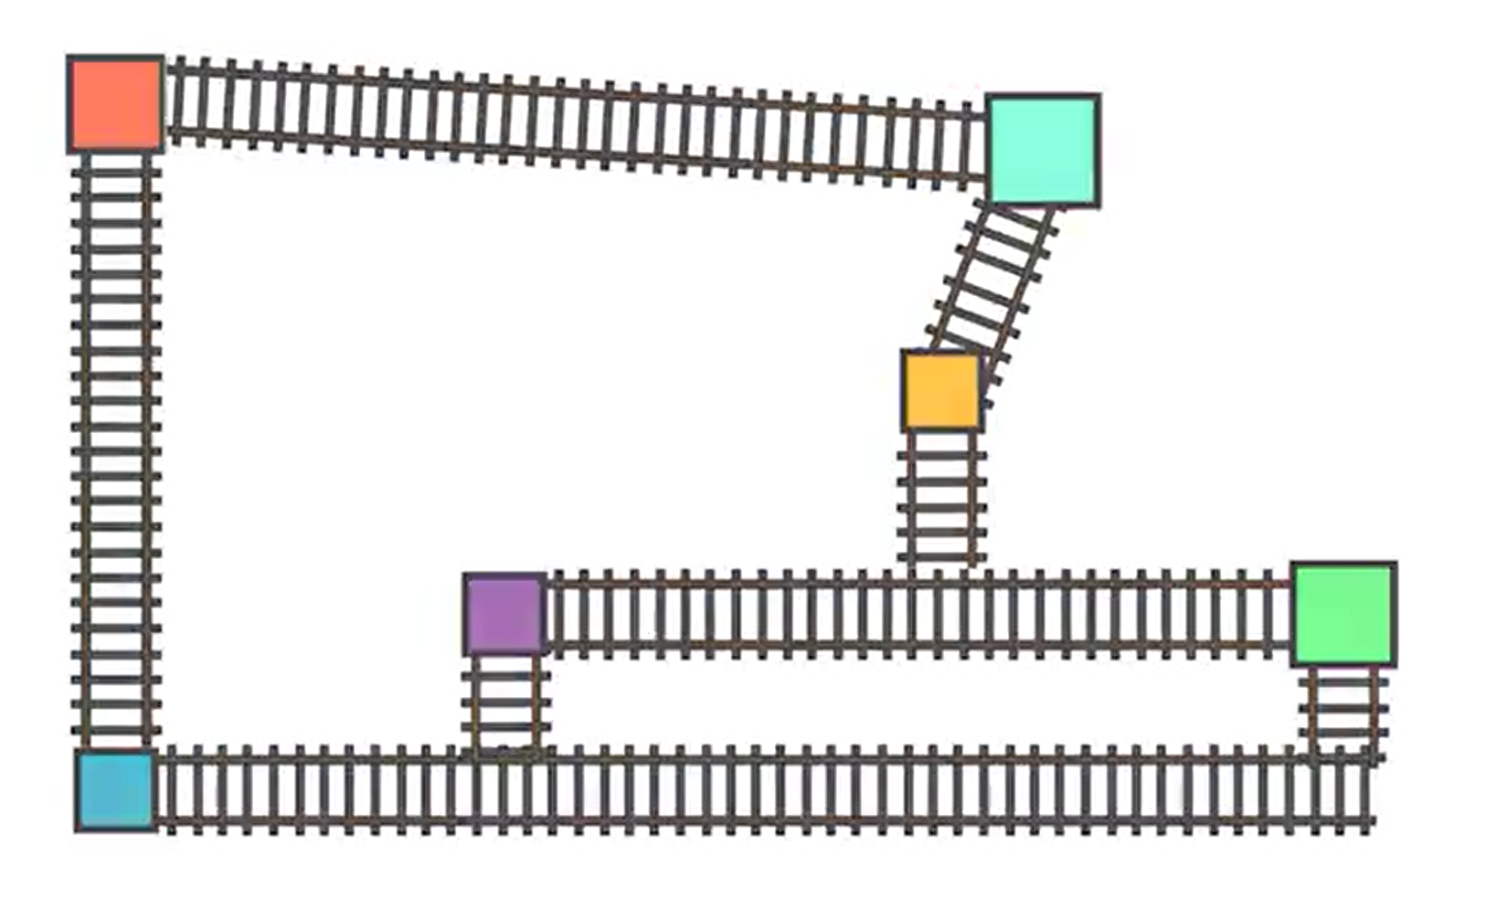
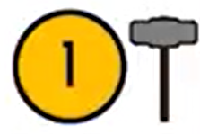
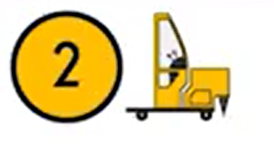

Slide 9
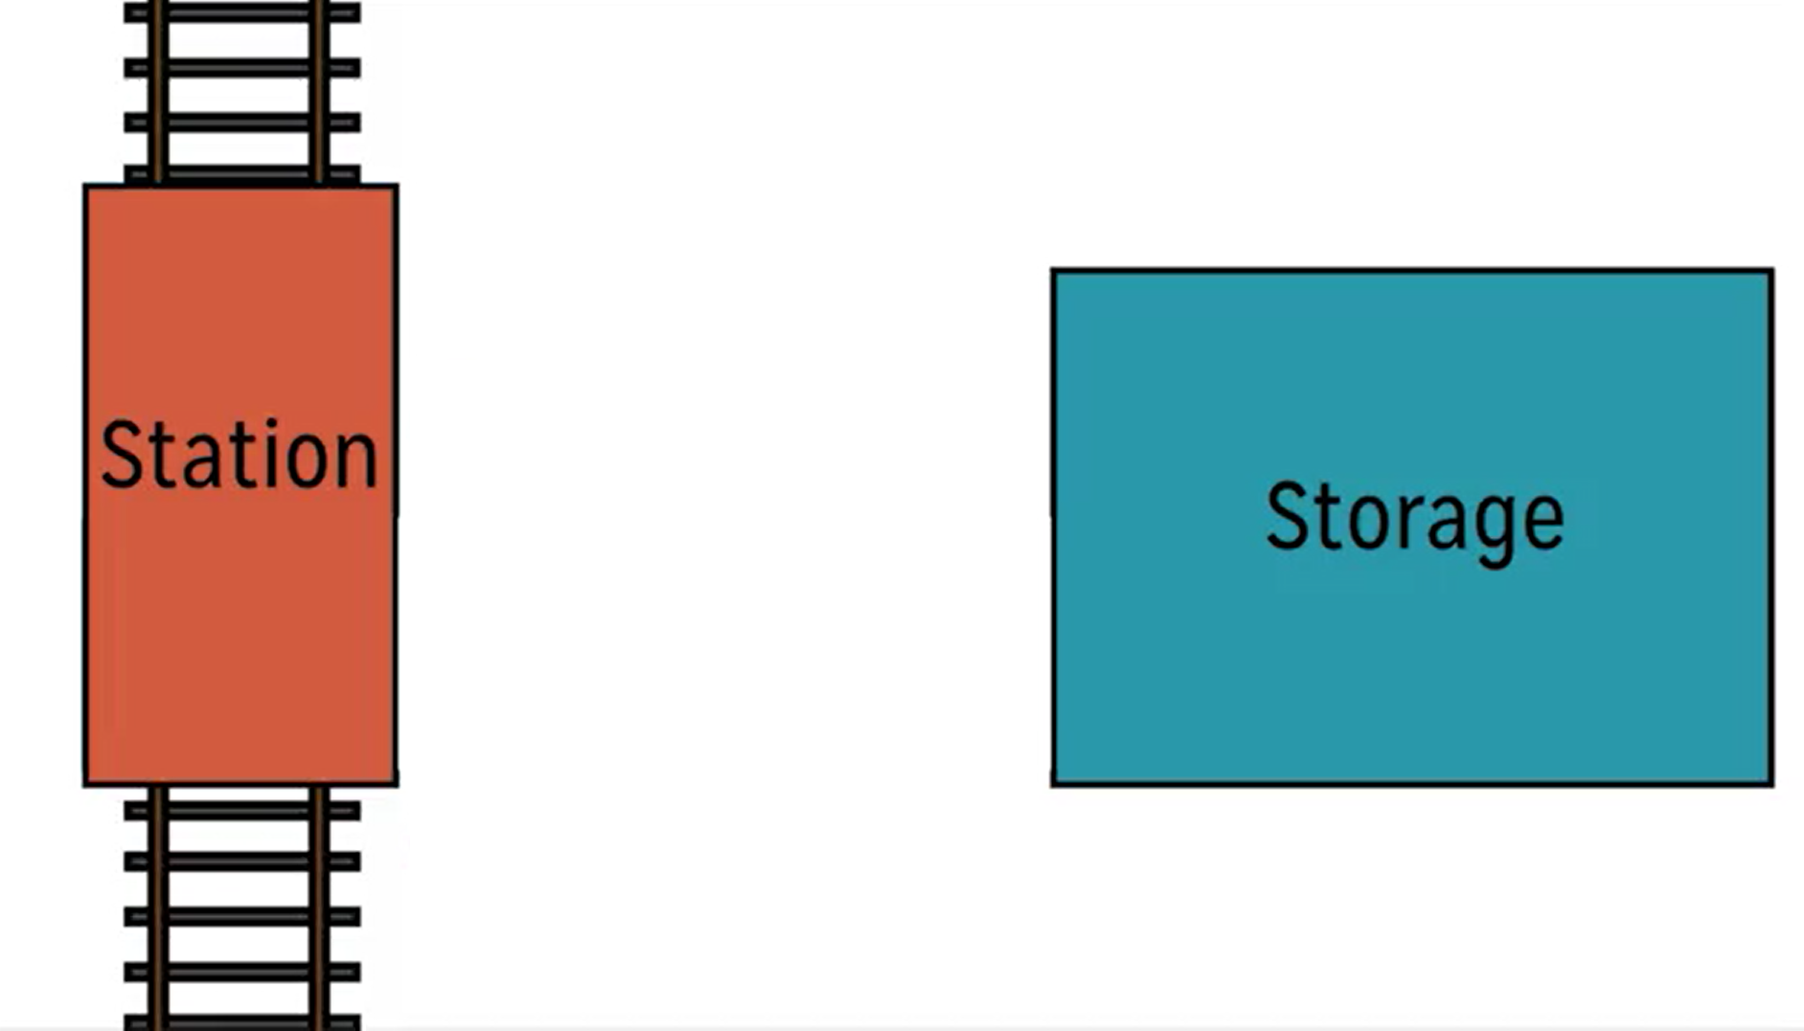

Slide 10
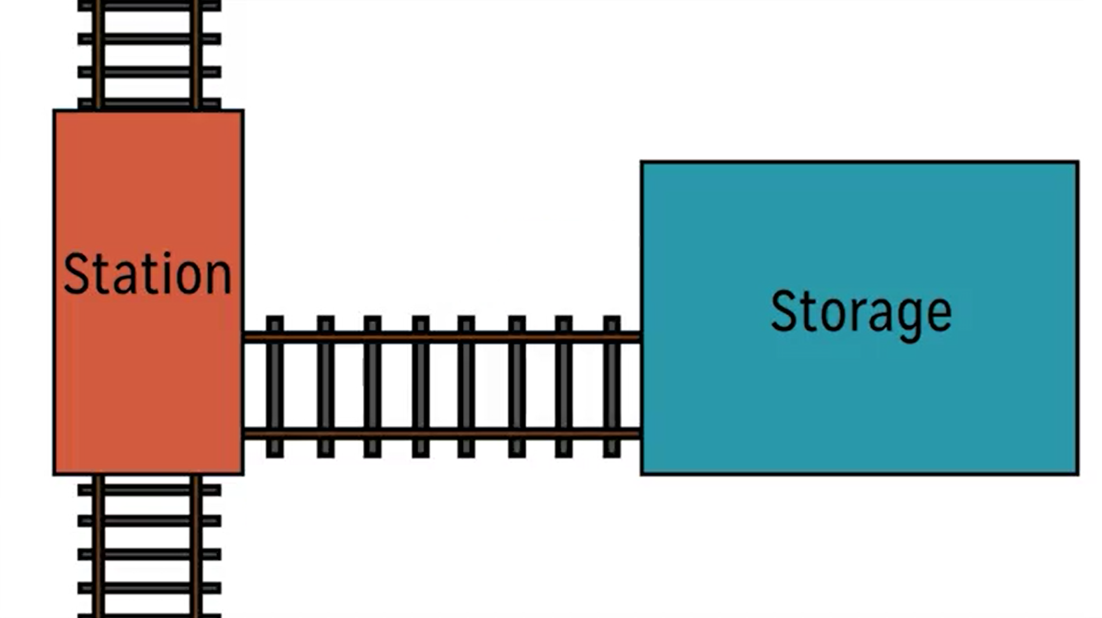

Slide 13
V Model
IT IS A VARIANT OF WATERFALL MODEL
EMPHASIZE ON VERIFICATION & VALIDATION, WHICH IS SPREAD OVER THE ENTIRE LIFECYCLE
TESTING ACTIVITIES ARE CARRIED OUT PARALLELLY AGAINST EACH PHASE OF DEVELOPMENT.

Slide 14
PLANNING
ACCEPTANCE TESTING
REQUIREMENT ANALYSIS
SYSTEM TESTING
HIGH LEVEL DESIGN
INTEGRATION TESTING
DETAILED DESIGN
UNIT TESING
CODING

Slide 15
When to use V Model
SYSTEMS REQUIRING HIGH RELIABILITY
ALL REQUIREMENTS ARE FROZEN
SOLUTION & TECHNOLOGY ARE KNOWN

Slide 16
Strength of V Model
EMPHASIZE ON VERIFICATION & VALIDATION OF THE SOFTWARE
ALL THE DELIVERABLES ARE TESTED.
EASY TO USE

Slide 17
Weakness of V Model
NO ITERATIONS
DIFFICULT TO ACCOMMODATE LATE CHANGES
NO RISK MANAGEMENT

Slide 18

TEST LEVELS

Slide 19
TEST LEVELS
SOFTWARE TESTED AT 4 LEVELS
UNIT TESTING
INTEGRATION TESTING
SYSTEM TESTING
REGRESSION TESTING

Slide 20
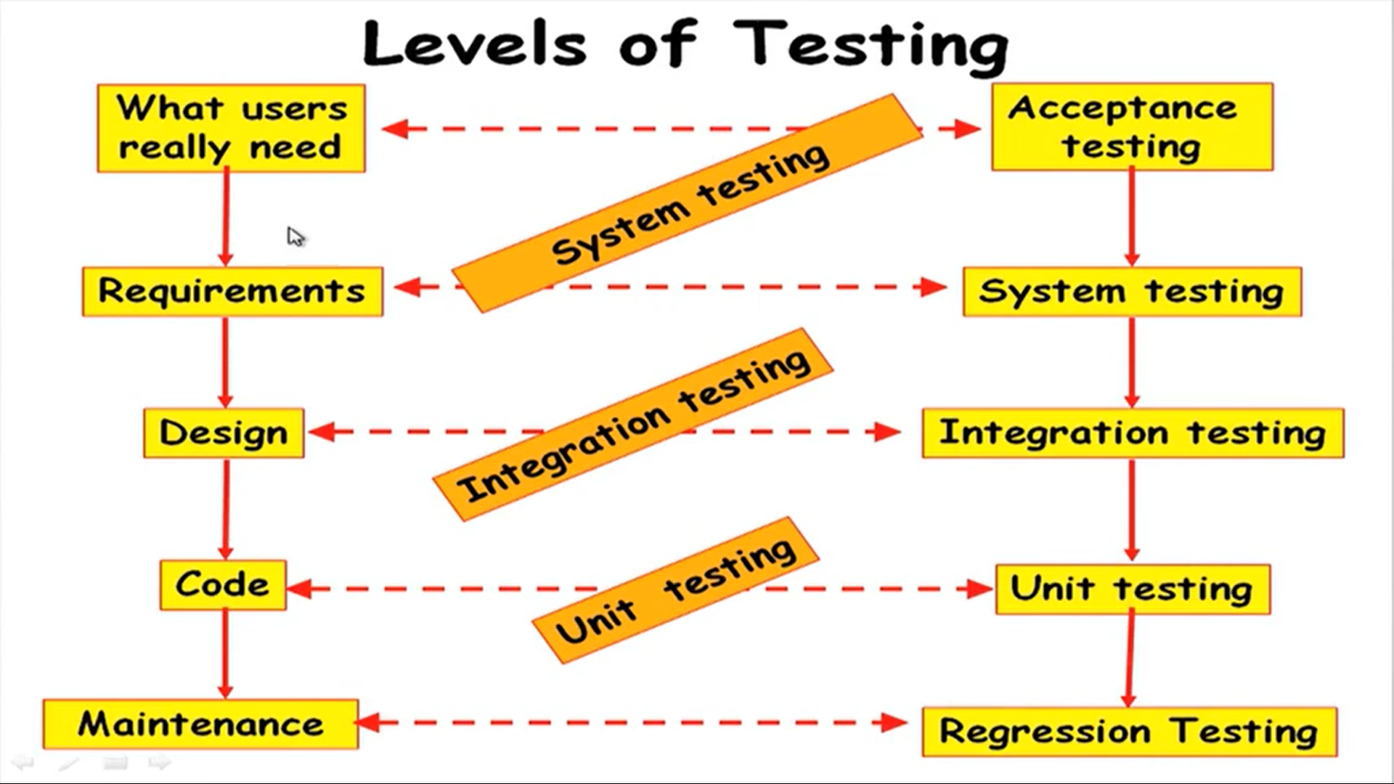

Slide 21
ACTIVITIES AT SYSTEM & INTEGRATION TESTING
TESTER
DEVELOPER
TEST SUITE DESIGN
RUN TEST CASES
CHECK RESULTS TO DEFECT FAILURE
PREPARE FAILURE LIST
DEBUG TO LOCATE THE ERROR
CORRECT ERROR

Slide 22
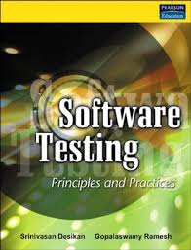



REFERENCES

